Slide 1
What's New
in Edge and Visual Studio

Slide 2
Windows Browser Roadmap
2009
2010
2011
2012
2013
2014
2015
2016
2017
2018
2019
2020
Windows 7
Internet Explorer 8
Starting January 12, 2016, only the most recent version of IE will be supported
Internet Explorer 9
Internet Explorer 10
Internet Explorer 11
Windows 8
Internet Explorer 10
Windows 8.1
Internet Explorer 11
Windows 10
Internet Explorer 11
Microsoft Edge
2009
2010
2011
2012
2013
2014
2015
2016
2017
2018
2019
2020
Notes:
This is the Windows Browser Roadmap.
As we announced last year, starting on January 12, 2016 only the most recent version of Internet Explorer will be supported on supported versions of Windows. Effectively this means that only IE11 will be supported on Windows 7 starting in January, 2016. The Windows 8 End of Life also occurs on that date. Please make sure that customers and partners understand this, as upgrading to IE11 helps defragment the ecosystem, reduces risk, and eases Windows 10 upgrades.
Internet Explorer 11 is available on Windows 7, Windows 8.1, and Windows 10, to help ease migrations to the latest operating system.
Windows 10 has two browsers available: Microsoft Edge is the default, but a version of Internet Explorer 11 will be available for customers who need backward compatibility.
Links:
IE Support Lifecycle Policy FAQ: http://support.microsoft.com/gp/Microsoft-Internet-Explorer
August, 2014 lifecycle announcement: http://blogs.msdn.com/b/ie/archive/2014/08/07/stay-up-to-date-with-internet-explorer.aspx

Slide 3
Why get your sites ready for the Microsoft Edge?
Lower your engineering costs & complexity
Less browser-specific code and reduced development/maintenance time due to interoperability focus
Lower operating costs and improved performance due to more efficient CPU, cache and network utilization
Windows as a Service: Users will be on Windows 10
Free upgrade for 12 months for Windows 8.x, Windows 7, and Windows Phone 8.1 users
Detailed analysis of existing Windows customer hardware leading to high confidence upgrades
450+ million devices eligible for upgrade to Windows 10 with Microsoft Edge
Microsoft Edge: The browser for doing
A new, unified browser that delivers the best web experience across Windows 10 devices
Immersive reading, easy annotation and sharing
Be more productive on the web with Cortana
Notes:
Timeline slide
Your users will be on Windows 10
Lower you engineering costs and complexity
Innovative new web based experiences to your users

Slide 4
Save time & money

Slide 5
New engine will save time & money
Reduce development time and effort
New rendering engine targets the interoperable intersection of Webkit (Safari) and Blink (Chrome)
Developers can write one code path for all browsers reducing engineering costs
Lower operating costs
With consolidated single code path you can cache more content on the edge of network infrastructure
Less round-trip traffic back to server, resulting in less CPU time & lower bandwidth costs
Performance increase
Single code path means increased cache hits (e.g. edge in-memory cache, web server cache)
More of your site can be pushed to edge cache increasing response time for end users
Footnote

Slide 6
Reduce engineering time and effort
Today, multiple code paths need to be maintained
With new engine built to be interoperable with modern standards
Incoming browser request
Incoming browser request
Legacy standards
Modern standards
Which browser?
EdgeHTML Webkit, Blink & Gecko code
Multiple IE code paths
Webkit, Blink & Gecko code
Notes:
IE 8: Sunsetting old versions.
What do you do about the existing IE versions that are still coming in? Need to mention the older versions. We’ll help by sunsetting and reducing fragmentation.

Slide 7
Single code path = lower OPEX & increased performance
Caching on the edge reduces traffic and CPU cycles on your server
Up to 40% of page fragments cached in infrastructure (*)
Proxy
CDN
Service X
PaaS server
Page
Browser requests page
Lower cost
Higher cost
Faster response times
Slower response times
*: Exact gains will vary by site depending on the amount of IE specific code in use
Notes:
On the right is the server where the page source is stored.
Some parts of the page will be computed by the local server. Parts of the page that are processed on the server every time are shown in Red.
Other parts of the page don’t need to hit the server CPU every time. These could be fragments or shards of the page like social networking buttons or display ads for example (shown in purple)
The users browser actually making the request is on the far left. As the request hit network infrastructure, caching kicks in and can reduce round trips to the server.
Here the parts of the page that have been proxied and haven’t expired are shipped down to the requesting browser at minimal cost and increased response time. (shown in green).
CDNs also take load off the server for images and video and get sent down to the users browser without requiring a round trip – again reducing costs and increasing performance (shown in blue)

Slide 8
Windows 10 Upgrade

Slide 9
Free Upgrade for 12 months
Upgrades to Windows 10 free for 12 months
100s of millions of Windows devices running Windows 7/8.1 and Windows Phone 8.1 are eligible
Upgrading the operating system provides Microsoft Edge as the default browser
Users will be able to upgrade via download at general availability

Slide 10
“With Windows 10, we’re moving from a product release model to a service model. Windows 10 could become the largest internet service on the planet as Windows becomes ‘evergreen’.”
– Terry Myerson
Notes:
Going evergreen
Ok cool – what’s the plan for updates? Monthly? Regular?
Working on the code all the time. At least every month to consumers. Magnitude of update will be determined.
Pushing out fixes and features.
Solid roadmap expectation
Spartan features are through the store. Platfom (Edge) is part of the OS
Windows as a service.

Slide 11

Overview

Slide 12

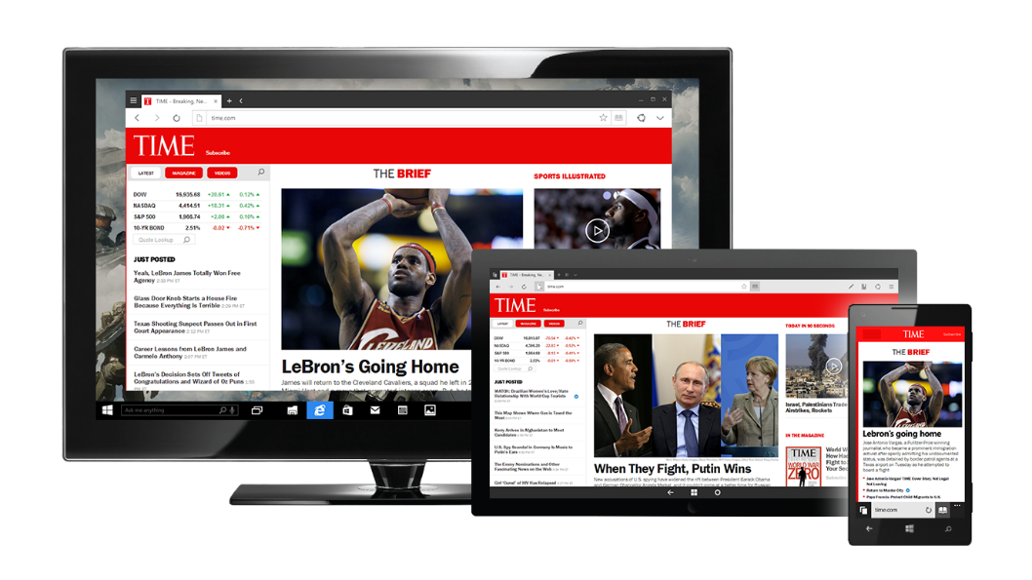
Introducing our new web browser
Faster, safer and sites “just work”
Always up-to-date, and with a new engine built for the modern web
More secure by default
Single codebase across all Windows 10 devices, with an experience that scales fluidly for each device
Set as default web browser for Windows 10
Notes:
Talking Points:
Microsoft listened. The next major version of our browser will work well with touch AND mouse/keyboard, across all Windows devices.
The Microsoft EdgeHTML rendering engine will be always up to date with modern standards.
Microsoft Edge is more secure by default, running with Enhanced Protected Mode and 64-bit processes.
Microsoft Edge will be the default browser for Windows 10 clean installs. For upgrades, users will be prompted to “reset app defaults” and MS Edge will also be set as default for upgrades if that is selected. Enterprises can override and set IE as default using group policy.

Slide 13

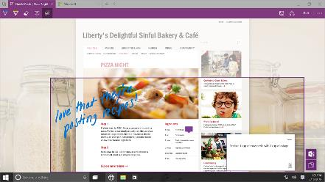

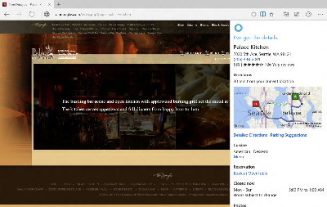
New experiences to make you more productive on the modern web
Capture and share your thoughts and ideas with web notes right on the page
The best place to read, with a distraction-free reading view, and gorgeous new Reading List to get you back to your interests.
Redefined around you, with Cortana built-in and ready to help you get things done on the Web
Notes:
Talking Points:
Microsoft listened. The next major version of our browser will work well with touch AND mouse/keyboard, across all Windows devices.
The “Edge” engine will be always up to date with modern standards, and Spartan also includes all of IE11’s backward compatibility features, so it’s easier to upgrade to Windows 10.
Spartan is more secure by default, running with Enhanced Protected Mode and 64-bit processes.

Slide 14
A Technical View
A Technical View

Slide 15
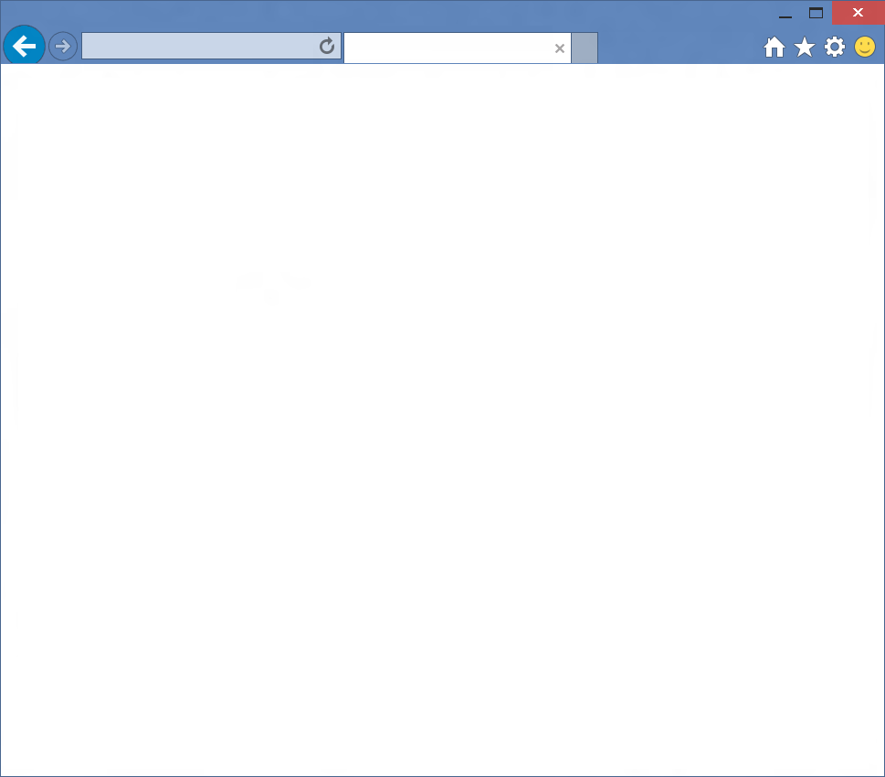


Slide 16
Browser
Internet Explorer
Web Platform
Trident

Slide 17
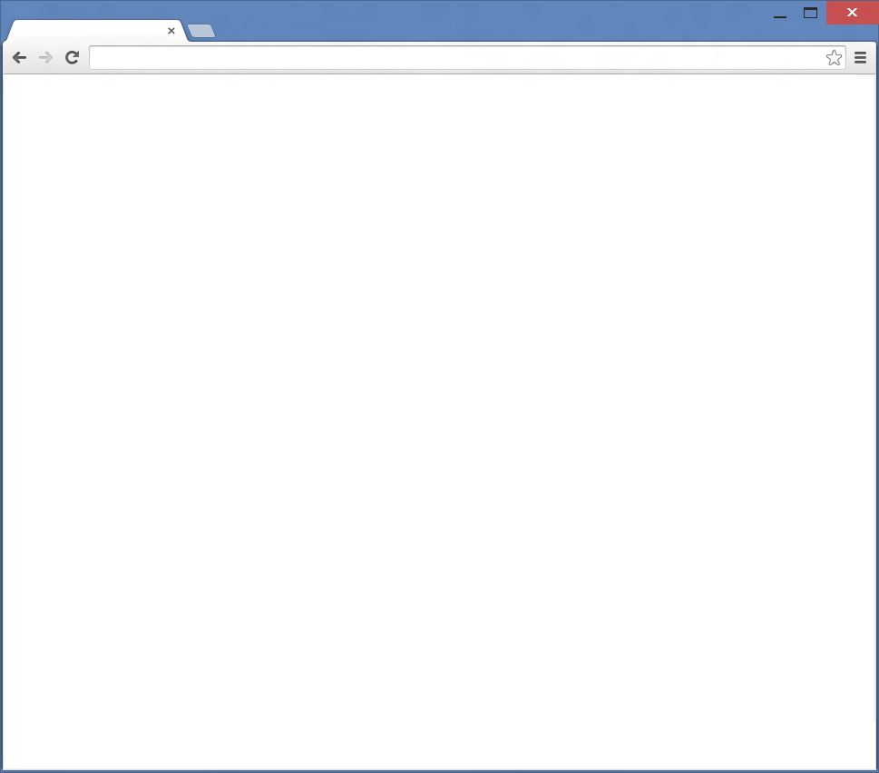

Browser
Chrome
Web Platform
Blink

Slide 18


Browser
Safari
Web Platform
Webkit

Slide 19
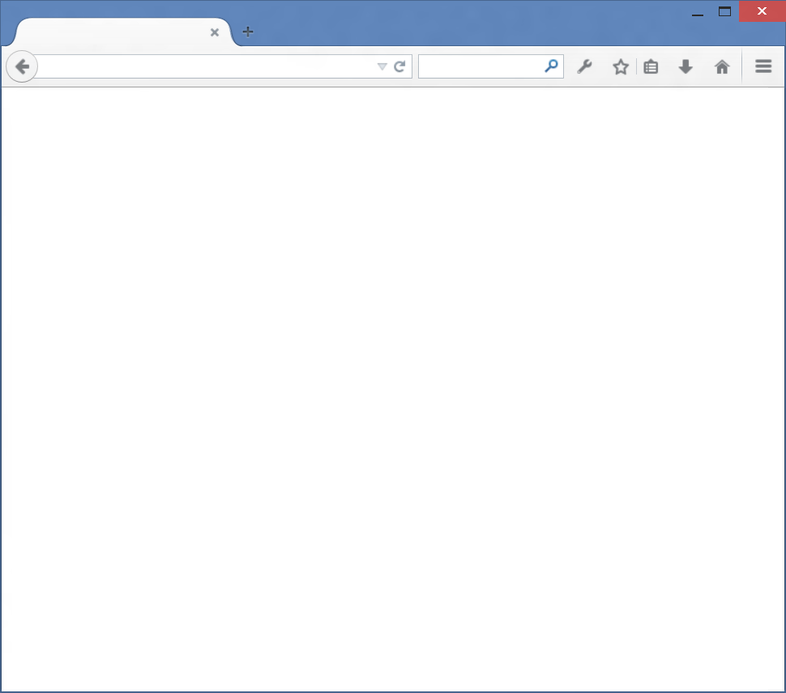

Browser
Firefox
Web Platform
Gecko

Slide 20
1995
2015
1
2
3
4
4.x
5
5.5
6
7
8
9
9
10
11
Trident

Slide 21

HTML4, ES3, CSS2
1995
2015
1
2
3
4
4.x
5
5.5
6
7
8
9
9
10
11
Trident
Quirks
Strict
!DOCTYPE

Slide 22
HTML4, ES3, CSS2
1995
1995
2015
1
2
3
4
4.x
5
5.5
6
7
8
9
9
10
11
Trident
Quirks
Strict
!DOCTYPE

Slide 23

HTML4, ES3, CSS2
CSS2.1
1995
2015
1
2
3
4
4.x
5
5.5
6
7
8
9
9
10
11
Trident
!DOCTYPE
IE5
Quirks
IE7
Compatibility View
IE8
Standards Mode
x-ua-compatible

Slide 24

HTML5, SVG, ES5
HTML4, ES3, CSS2
CSS2.1
1995
2015
1
2
3
4
4.x
5
5.5
6
7
8
9
9
10
11
Trident
IE5
Quirks
IE7
Compatibility View
IE8
Standards Mode
!DOCTYPE
x-ua-compatible
IE9
Standards Mode

Slide 25
HTML5, SVG, ES5, CSS3
HTML4, ES3, CSS2
CSS2.1
1995
2015
1
2
3
4
4.x
5
5.5
6
7
8
9
9
10
11
Trident
IE5
Quirks
IE7
Compatibility View
IE8
Standards Mode
!DOCTYPE
x-ua-compatible
IE9
Standards Mode
QME
Quirks Mode Emulation
IE10
Standards Mode

Slide 26
Modern Web
HTML5, SVG, ES5, CSS3
Legacy Web
CSS2.1
HTML4, ES3, CSS2
1995
2015
1
2
3
4
4.x
5
5.5
6
7
8
9
9
10
11
Trident
IE5
Quirks
IE7
Compat View
IE8
Standards Mode
EMIE
Enterprise Mode
!DOCTYPE
x-ua-compatible
IE9
Standards Mode
IE10
Standards Mode
QME
Quirks Mode Emulation
IE11
Standards Mode

Slide 27
Gecko
Firefox
Evergreen

Slide 28
Blink
Chrome
Evergreen

Slide 29

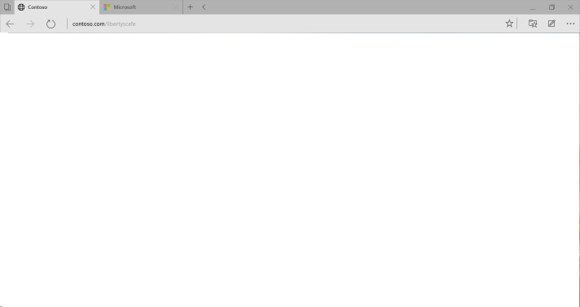
Microsoft EdgeHTML
Evergreen

Slide 30
Modern web interoperability

Slide 31
Interoperability goals
Our goal is “the web just works”
Sites authored for Firefox, Chrome and Safari “just work” with Microsoft Edge
Evolve at the speed of the web and only support latest version
Use standards as a reference but prioritize real-world interop (and then fix standards if needed)
Allow web developers to target a single version
Internet sites use the new rendering engine (EdgeHTML) by default
New update cadence to ensure browser is always up-to-date
Make a clean break from the past
Interoperable user-agent string to get the same content as other browsers (no IE specific code)
Over 4200 interoperability fixes, and 45+ new features to render it correctly
Remove IE specific behaviors

Slide 32
Interoperable UA string
Interoperability Trident (EdgeHTML)
Mozilla/5.0 (Windows NT 10.0; WOW64) AppleWebKit/537.36 (KHTML, like Gecko) Chrome/39.0.2171.71 Safari/537.36 Edge/12.0
Chrome
Mozilla/5.0 (Windows NT 10.0; WOW64) AppleWebKit/537.36 (KHTML, like Gecko) Chrome/39.0.2171.95 Safari/537.36

Slide 33
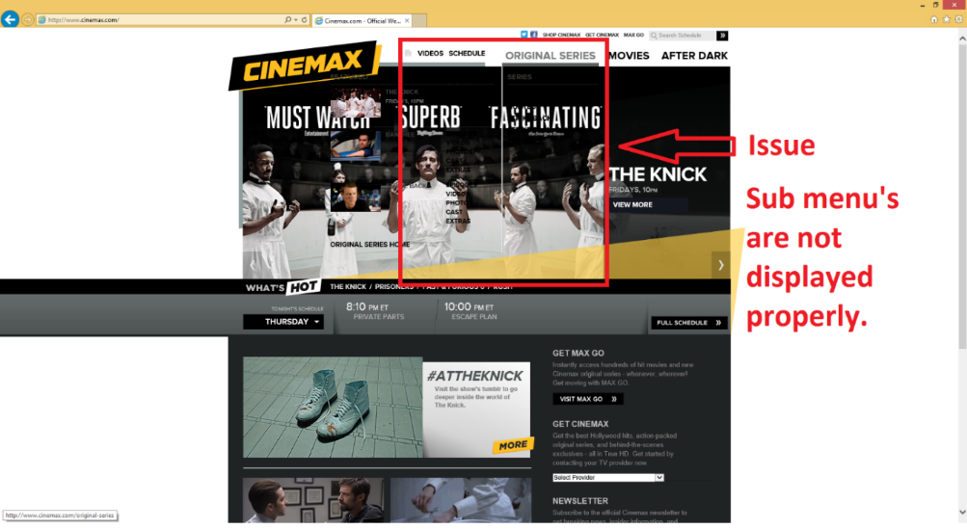
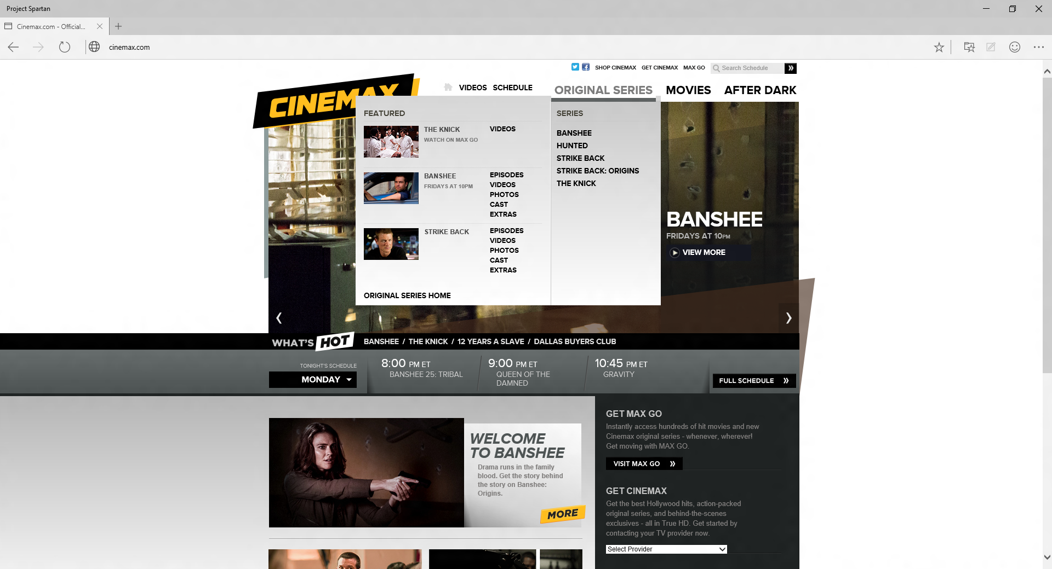
IE11 on Windows 8.1
MS Edge: With support for –webkit transitions
Notes:
Note: cinemax is currently CV-listed to IE9 docmode, so if someone tries this, they won’t see any bugs.

Slide 34

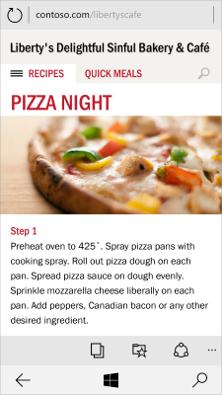
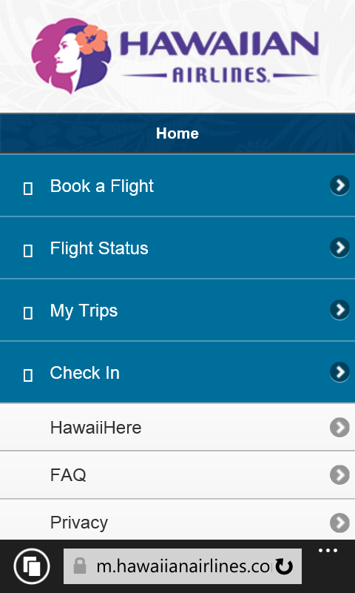
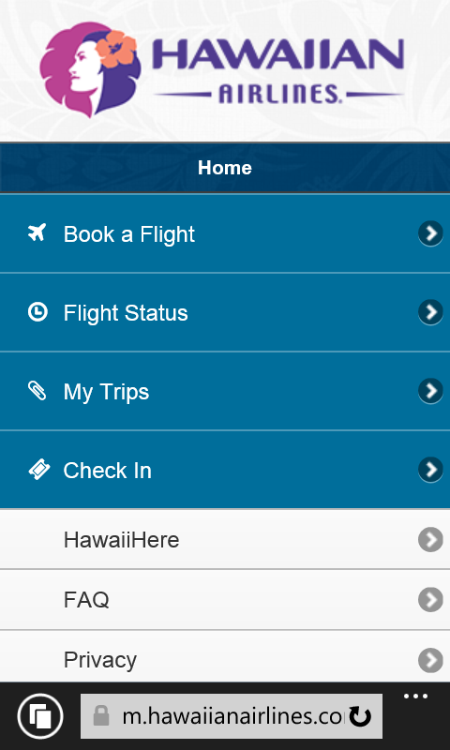
m.hawaiianairlines.com
m.hawaiianairlines.com
WP8.1 + GDR1: Removing security constraints on downloaded fonts
WP8.1 + New user-agent
Windows Phone 8.1
Notes:
Note: these changes were shipped in an update to Windows Phone 8.1, so if someone tries this, they won’t see the bug.

Slide 35


m.macys.com
Windows Phone 8.1
Windows Phone 8.1 + GDR1: With support for –webkit-gradient

Slide 36
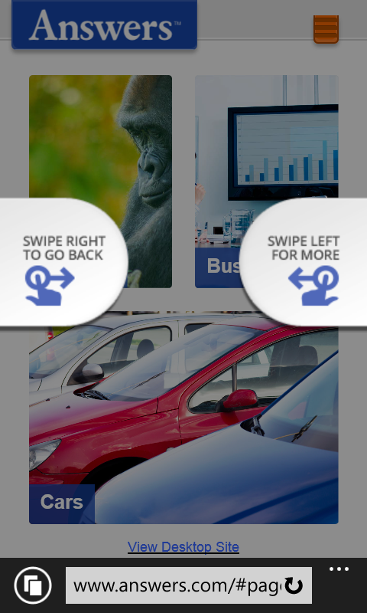
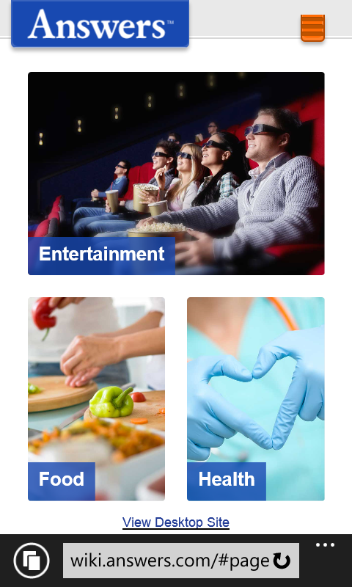
www.answers.com/#page
WP 8.1 – swipe doesn’t work
WP8.1 + GDR1: Swipe works with touch events support

Slide 37




Interoperable intersection
The Mobile Web
Notes:
Start: all browsers had unique behaviors (not drawn to scale – meant to emphasize the point)
Build: Purple overlay - First step was to remove IE specific behaviors once EdgeHTML was split from MSHTML
Build: Green overlay - Second step was to add behaviors at the intersection of other modern browsers – these are especially important for the mobile web, but not exclusively.

Slide 38
Interoperability Features
3000+ Interoperability Fixes, Preserve-3d, Touch Events, CSS Filter Effects, DOM Clipboard Support, HTML Drag and Drop, Web Audio, CSS Position Sticky, CSS @supports, CSS Flexbox, HTML Beacon, WebDriver, IndexedDB, WebCrypto, Internationalization Mixed Languages Support, CSS Grid, CSS Variables, srcset, <picture> element, Web Workers Update, DOM4 Events, Font Loading, BDI, Cross-domain, HLS Manifest, Block Ellipsis, WAV, @rules, CSS Text(), CSS Border Logical, Logical Box Model, DOM Gamepad API, DOM FileSystem API, HTML <date> element, HTML <keygen> element, HTML <main> element, HTML <output> element, HTML <summary> element, HTML <detail> element, HTML <time> element, Native PDF, AppCache, SVG Hosting, Mutation Observers, HTML bidirectional, HTML Speech API, SVG animations, SVG transitions, SVG transforms, Canvas Path, Canvas Accessibility API, CSS Select Control, CSS Masking, CSS Clipping, Navigation Error Logging, CSS element(), CSS Shapes, ORTC, CSS Escape, Shared Workers, ES6 Modules, ES6 Promises, CSS Intrinsic & Extrinsic Sizing, Web Components, CSS Scoped Styles, HTTP 2.0, CSS Resize, WebGL, Canvas Blend Modes, CSS Interpolation, CSS Line Grid, CSS Line Box Contain, CSS Ruby, DOM Event Constructors, HTML <ol> Reverse, Server-Sent Events, Viewport APIs, Quota API, etc.
http://dev.modern.ie/status
Notes:
In addition to more than 2,000 interoperability fixes, we are focusing efforts on many interoperability features. For example, the Edge mode will now support webkit extensions that are popular on many websites. For more detail on the status of a particular web standard, you can visit http://status.modern.ie.

Slide 39
Legacy Compatibility
Notes:
Just because we have built this new engine and browser focused on the modern web doesn’t mean we’ve forgotten about legacy compat.

Slide 40
Legacy Compatibility
If Microsoft Edge runs into content that requires legacy IE functionality that is no longer supported, it will launch IE for that site.
IE will not be pinned to the taskbar
IE will be moved into the “Windows Accessories” folder in Start
Enterprises with a lot of content that requires legacy IE functionality can choose to enable IE11 as the default browser while they transition content to modern standards
IE11 on Windows 10 will continue to support Enterprise Mode for high fidelity IE8 emulation
IE11 on Windows 10 has full parity with IE11 on Windows 7/8.x for compatibility
Eases transition to Windows 10 for some enterprises with legacy web app needs
Notes:
IE in “Windows Accessories” shows that IE should be viewed as a utility in the Win10 timeframe (by default).

Slide 41
Extensions

Slide 42
Extensibility
Internet Explorer has supported nearly 30 different legacy extension points for nearly 2 decades.
Includes: ActiveX, Toolbars, BHOs, many others.
Legacy extension points affect security, reliability and performance, and limit browser innovation.
Internet Explorer on Windows 10 will continue to support these extension points for enterprise compatibility.
Microsoft Edge is designed for the modern web and does not support IE legacy extensibility points.
It does support both platform and browser extensions:
Native support for Flash and PDF
Modern JavaScript-based extension model coming later in 2015

Slide 43
Deployment & Security

Slide 44
Microsoft Edge Deployment and Updates
Deployment
Microsoft Edge will be pre-installed on Windows 10 PCs and mobile devices
Internet Explorer will be available for Windows 10
Updates
Microsoft Edge updates will be released on a regular cadence
Preview channels
Microsoft Edge preview releases will be available for early validation and feedback via the Windows Insider Program

Slide 45
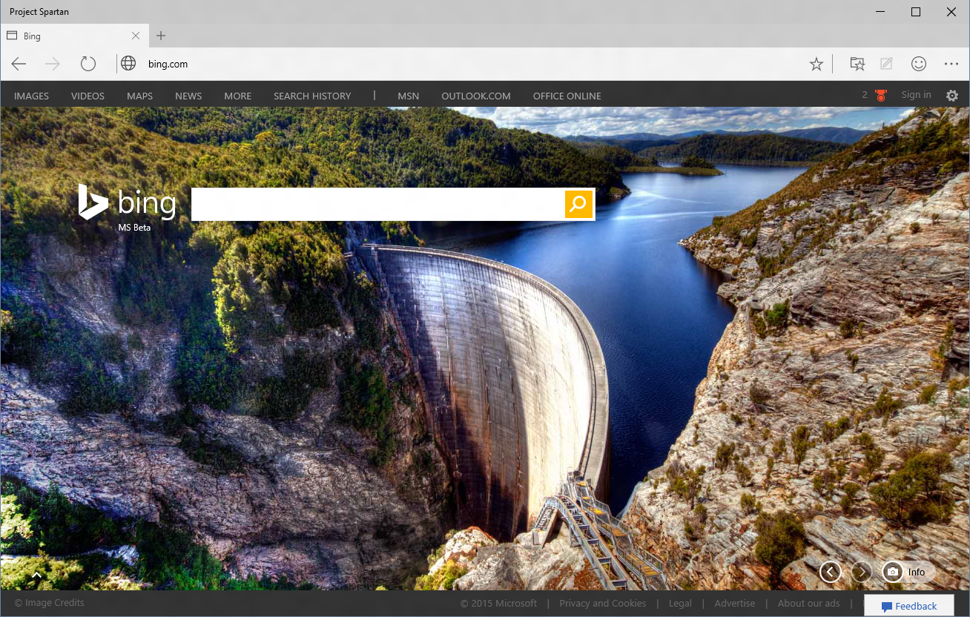
Securing Microsoft Edge
Multi-process architecture
- MS Edge frame itself runs in App Container
- Tabs run in EPM
Extensibility
- Constrained ActiveX controls
- No Toolbars or BHOs
Rigorous Memory Protection
Reduced Attack Surface
SmartScreen Getting Smarter
Microsoft Edge
Security Investments
App Container
64bit Protections
Windows
Platform
July 28, 2015
Microsoft Confidential
Notes:
Talking points:
Microsoft Edge is a modern Windows App, taking full advantages of the platform protections offered by App Container.
Even if MS Edge is compromised, the platform prevents malicious code from escaping the sandbox.
IE Classic in contrast, runs the frame process at MediumIL
EPM: Tabs run in separate processes also protected by app container
By default ActiveX will be limited to a small list of known good ActiveX controls beyond Flash, which remains built in.
Toolbars and BHOs, a common source of security and performance problems will simply not load in Microsoft Edge
See http://blogs.windows.com/msedgedev/2015/05/11/microsoft-edge-building-a-safer-browser/
In IE 11 over the last several months we have introduced memory protections that have eliminated broad sets of security threats
IsoHeap and Memory Protector have proven valuable.
http://securityintelligence.com/understanding-ies-new-exploit-mitigations-the-memory-protector-and-the-isolated-heap/#.VMrz-P50wuU
We are continuing to invest in stopping exploits where they start – by preventing memory from being abused by an attacker
These protections will appear in Windows 10/Microsoft Edge first and will be backported as makes sense.
64bit by default also makes it very hard to attack memory via a heapspray or by breaking ALSR
Microsoft Edge is a complete re-write of the Browser, allowing us to deprecate a significant amount of code, and legacy interfaces that are no longer present to be attacked
We are working to make SmartScreen even smarter – currently protects users from Phishing and malicious downloads, in the future will also project you from malicious sites.

Slide 46
Testing Compatibility

Slide 47
WebDriver
WebDriver does work with Internet Explorer
Set IE to new engine in Windows 10 to execute tests
WebDriver support in Microsoft Edge in planned
Timing is TBD
IE WebDriver Tool for Internet Explorer 11
http://www.microsoft.com/en-us/download/details.aspx?id=44069

Slide 48
http://dev.modern.IE
Microsoft Confidential

Slide 49
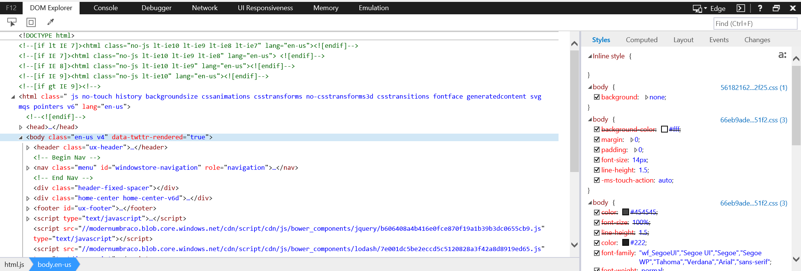
F12 Tools
Microsoft Confidential

Slide 50
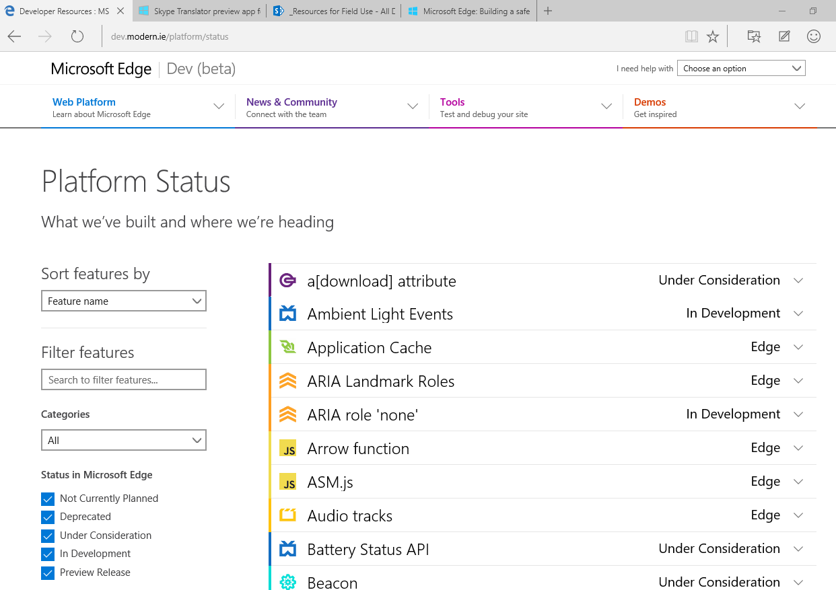
http://dev.modern.ie/platform/status/
Microsoft Confidential

Slide 51
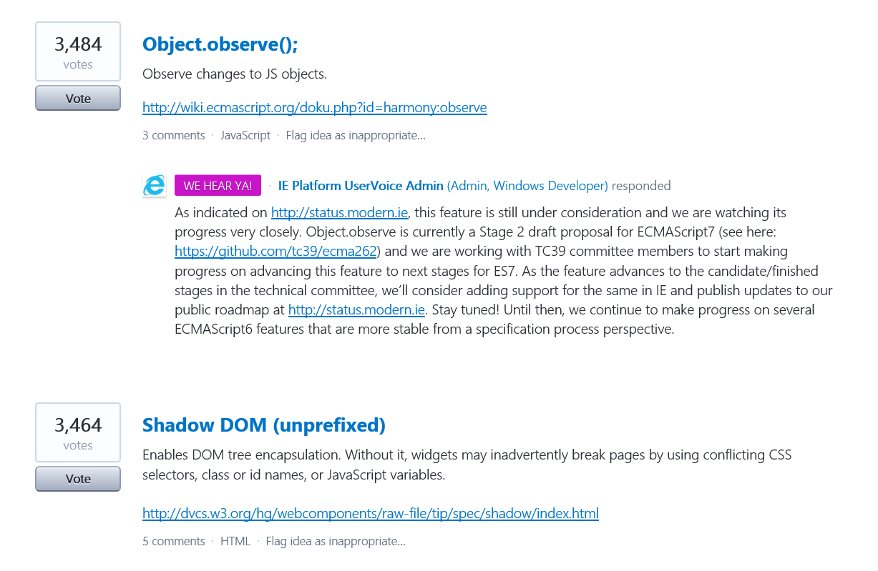
uservoice.modern.ie
Microsoft Confidential

Slide 52
Summary

Slide 53
Summary for Windows 10
Microsoft Edge brings a fresh browsing experience across Windows 10
Great new features for all users including Cortana integration, reading view & annotations.
Included in the Windows Insider Program
Get current / Stay current
Enable users to confidently move to the latest version of Microsoft Edge
Regular updates rolled out to Microsoft Edge along with “Windows as a Service”
Interoperability and compatibility
New engine with focus on interoperability with modern browsers and new HTML5 functionality
IE with Enterprise Mode provides high fidelity backwards compatibility for LOB apps
New Enterprise Mode Tooling for site discovery and list management to ease upgrades
Security and data protection
Many new capabilities and protections, including enabling EPM (enhanced protection mode) and 64 bit

Slide 54
Content and HoL

Slide 55
Call to actions
Validate the new UA with your site
Use remote.modern.ie to test the latest version of IE
Do use feature detection
Do not sniff UA
Send us feedback

Slide 56
Visual Studio Web Tools
Rich Editor
Features
Browser Link
Web Essentials

Slide 57
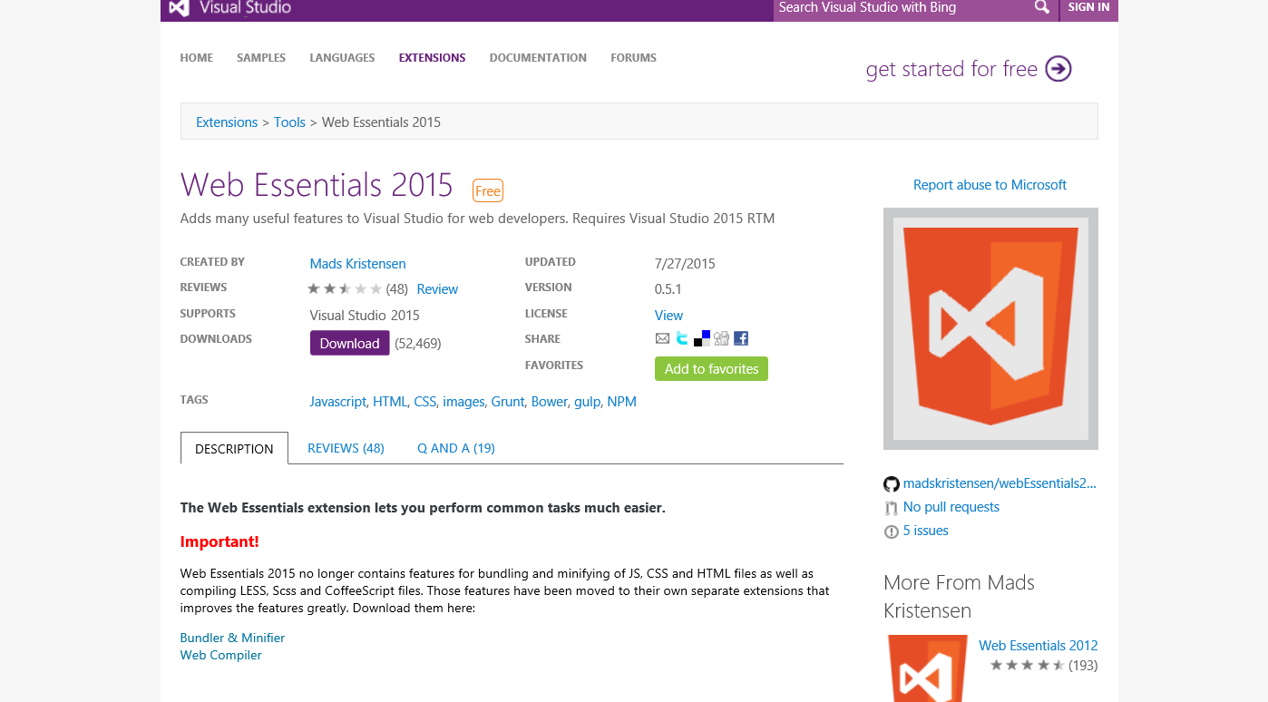
Web Essentials
Notes:
https://visualstudiogallery.msdn.microsoft.com/ee6e6d8c-c837-41fb-886a-6b50ae2d06a2

Slide 58
Visual Studio 4.6 – Web Forms

Slide 59
Demo browser Link

Slide 60
Demo HTML, CSS and JS editors

Slide 61
HTML Editor ng

Slide 62
